Slide 1

Azure for “Normal” People - Remote Edition -
Open the Presentation and Remote Worksheet

Slide 2
Azure for “Normal” People
Arrange yourselves into four co-operative working groups (3 groups of 4 learners)
In your groups, write a list of all the “Azure Words” you know

Slide 3
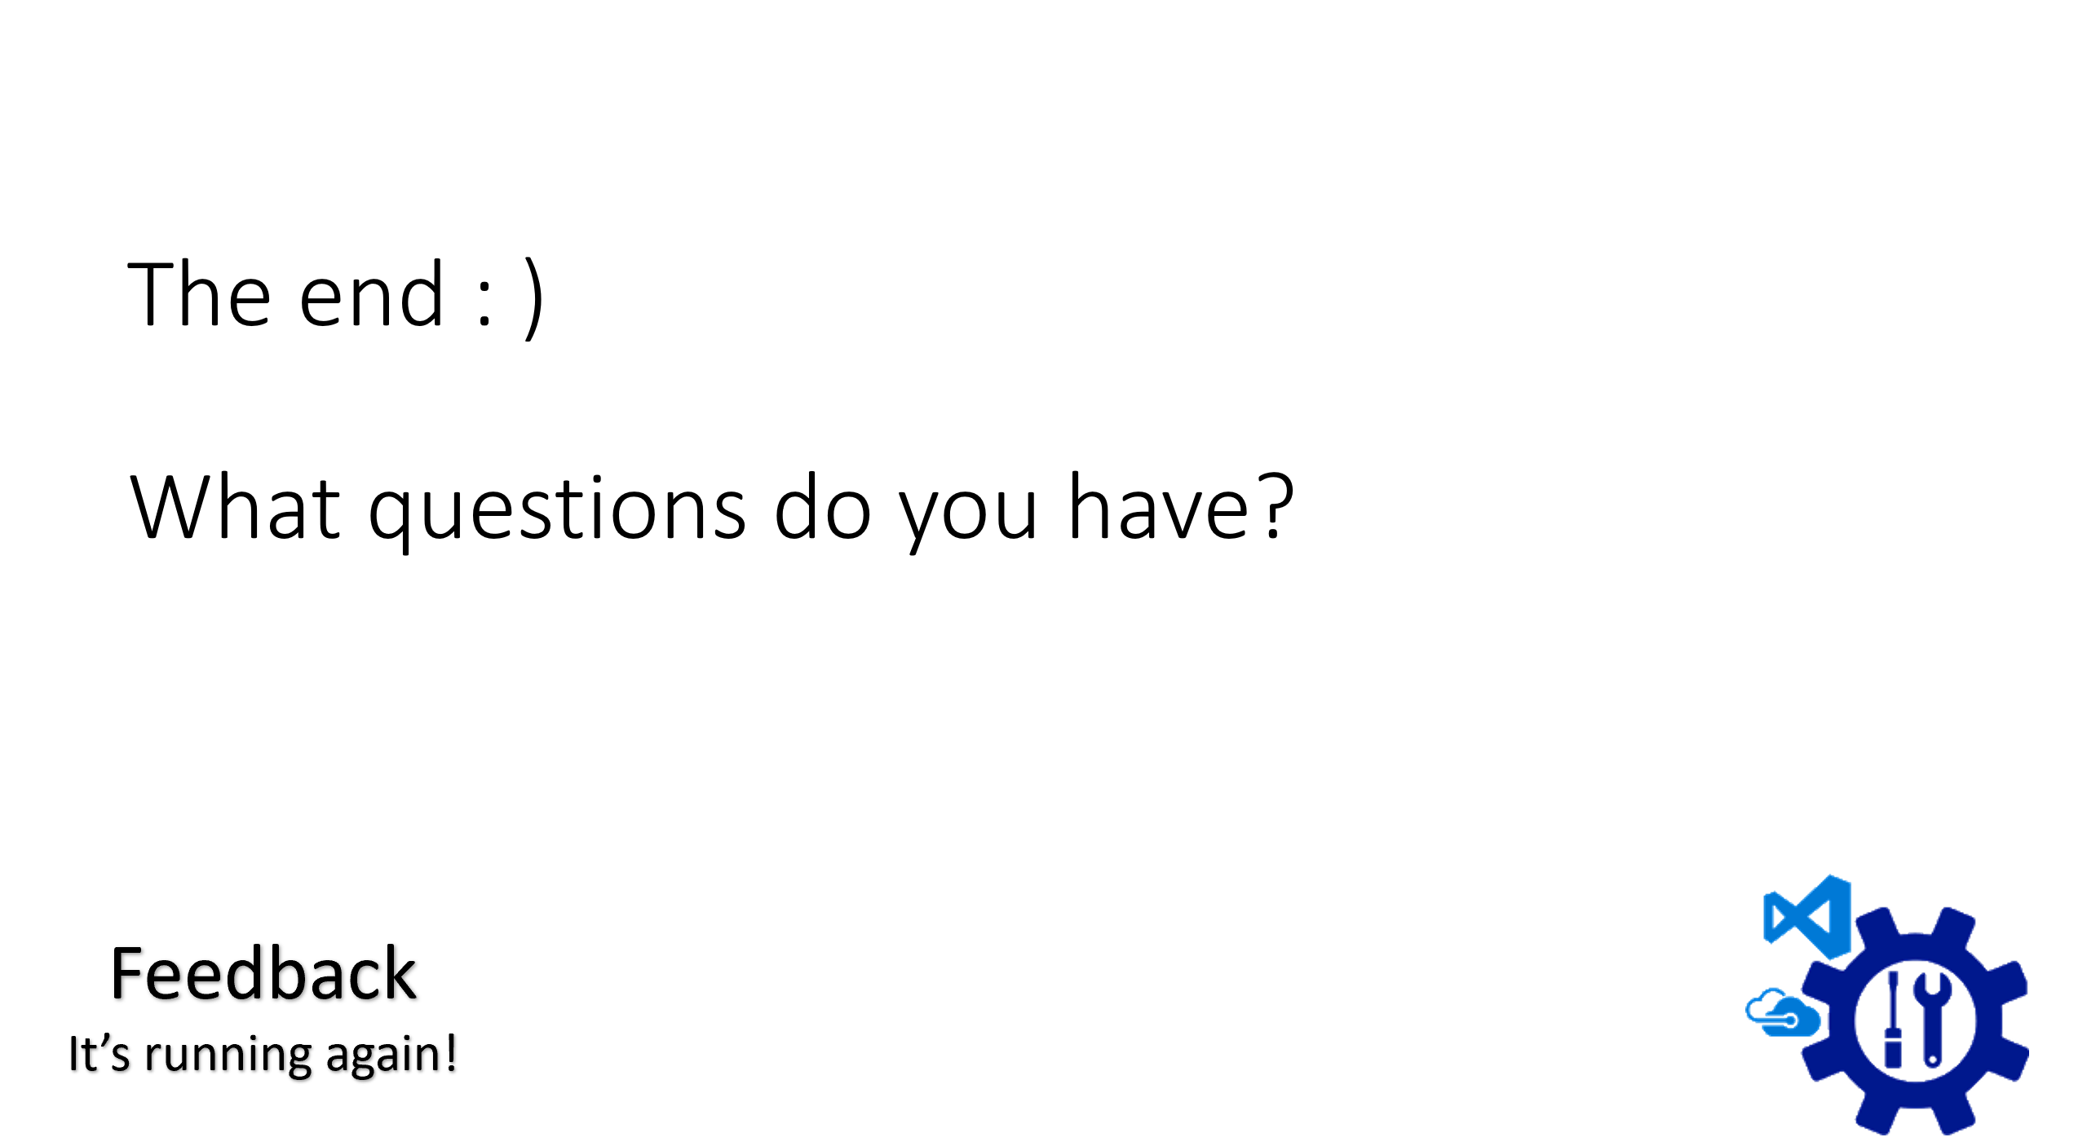
What it’s about
What it’s not about
Build-a-Cloud
So what?

Slide 4
Change
repeatability
supportability
extensibility
Whole Life Support
accessibility
- self service
DevOps
maturity
elevate state
Principles
automation
Scaling and Performance
Cloud
Vs
On-Prem
Azure
Recoverability not Reliability

Slide 5
Poetic license has been taken Ask questions – come off mute, or ask in chat Break Remote Edition: If PowerPoint diagramming doesn’t work for you, abandon it

Slide 6

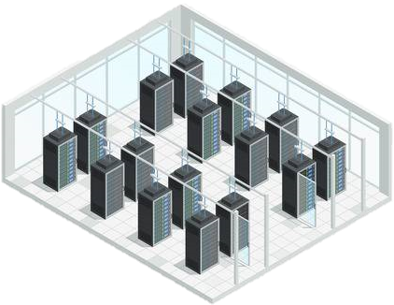
The Cloud

Slide 7
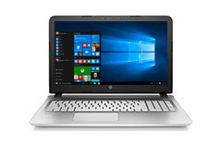
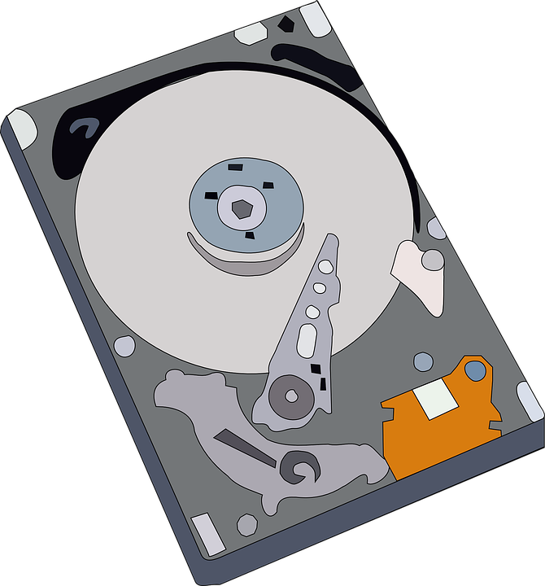
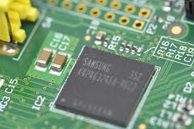





Slide 8
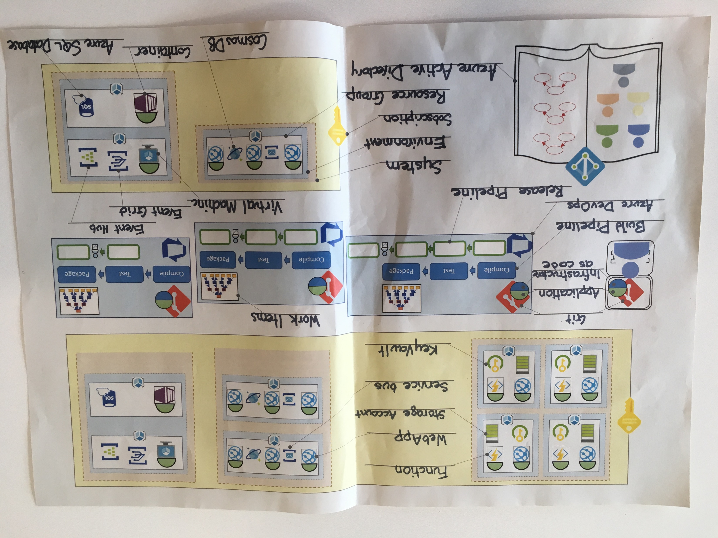

Slide 9
OMG we sold something!
As a
Local Authority
I want
a list of Residential Buildings in an area
So That
I can use that data to make plans

Slide 10
Geographic area in
List of residential buildings out
Interaction and Display on a webpage

Slide 11

☑ Approvals
☑ Business Case
☑ Management Sign off
☑ Budget
☑ Sufficient Coffee
☑ Cost Codes
☑ Investment Requests
☑ Training Requirements
☑ Developer Cake
☑ Development Space
☑ Architecture Review Board
Alex
Name your developer - Place your laptop

Slide 12
Developer
Laptop
Application
Application
Application
Place application on laptop

Slide 13

Developer
Laptop
Application
Version Control
Experimental changes.
Need to spike.
Need to safely trash changes.
Version Control (Git)
Place application on Git on laptop

Slide 14

Developer
Laptop
Application
Version Control
Subscription
Need to deploy to Azure
Subscription
Add subscription – Name it a breakfast food

Slide 15

Developer
Laptop
Application
Version Control
Subscription
ARM
Need Authorisation
Azure Resource Manager
The ARM

Slide 16
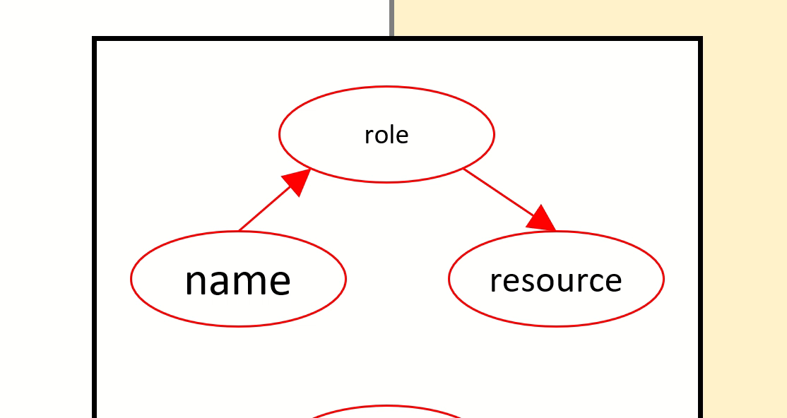

Developer
Laptop
Application
Version Control
Subscription
ARM
Need Authorisation
… has the role of…
… on the resource called…
Alex
Contributor
eggs
Role Based Access Control
RBAC
in the
Azure Resource Manager
The ARM
Give your developer access to your subscription via the ARM

Slide 17

Developer
Laptop
Application
Version Control
Subscription
ARM
Need “Who”
Need Authentication
Azure Active Directory

Slide 18
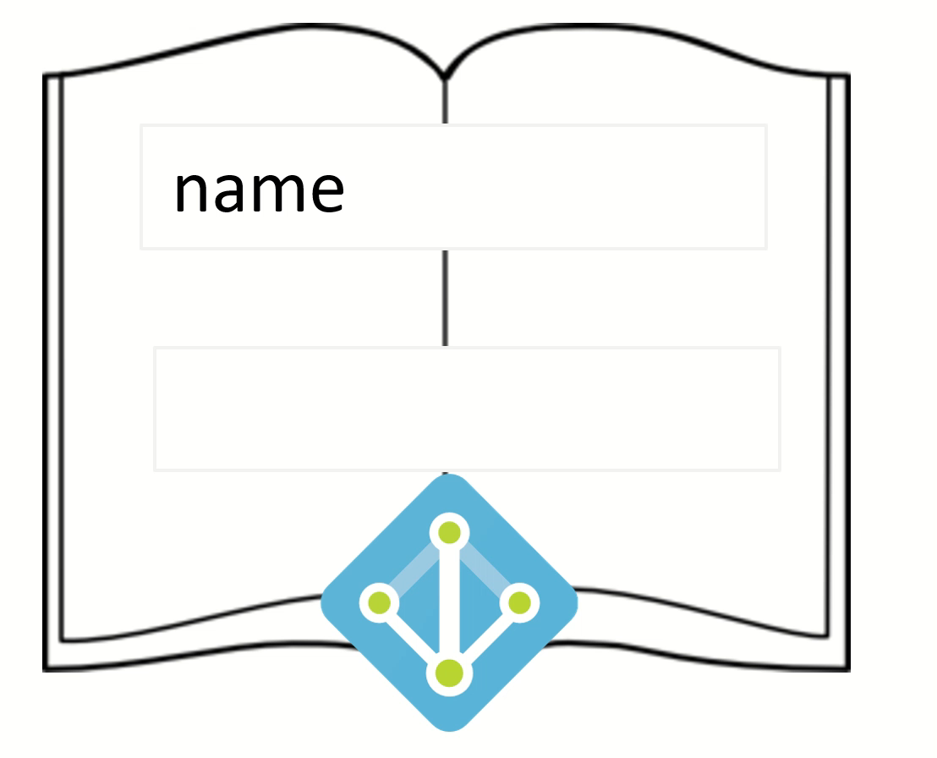
Users
Alex
Azure Active Directory
Groups
Group Name:
Users:
Group Name:
Users:
Add your developer to AAD

Slide 19


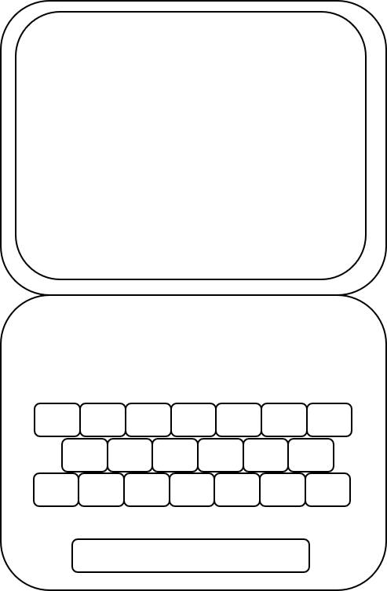

Alex
Application
Contributor
Alex
eggs
Alex

Slide 20
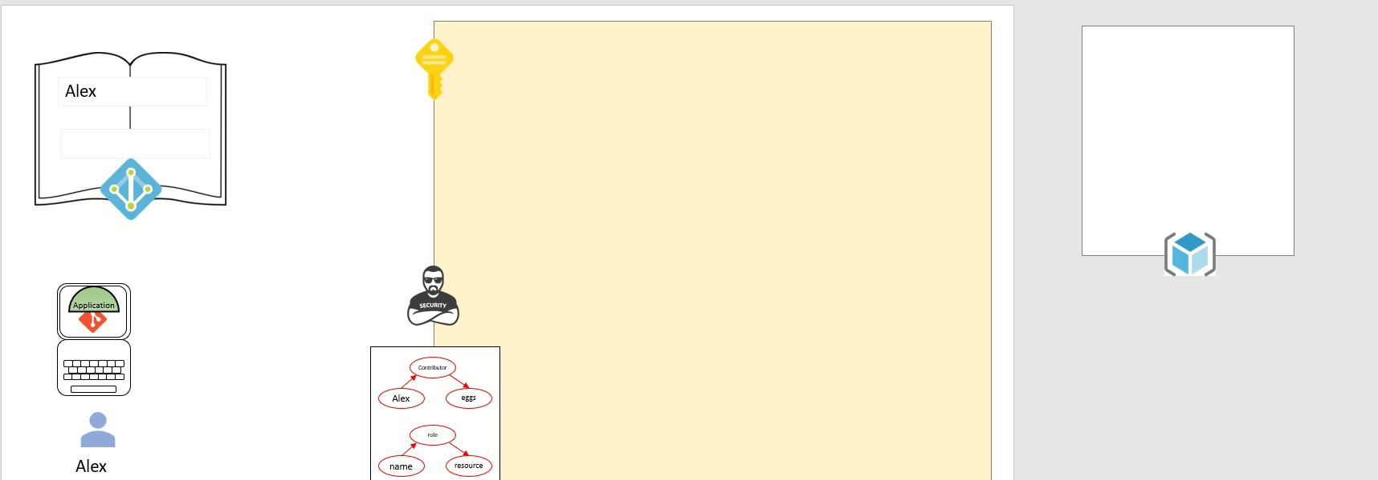

Developer
Laptop
Application
Version Control
Subscription
ARM
AAD
Resource Group
Need to deploy to Azure
Resource Group
Add Resource Group to Subscription

Slide 21



Developer
Laptop
Application
Version Control
Subscription
AAD – user and permission
Resource Group
Execution Environments
Application
WebApp
Add WebApp to Resource Group – run a copy of the application on it

Slide 22
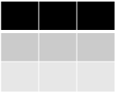
Developer
Laptop
Application
Version Control
Subscription
AAD – user and permission
Resource Group
WebApp + Application
Table Storage+ Storage Account
Need real data
Table
Table Storage

Slide 23
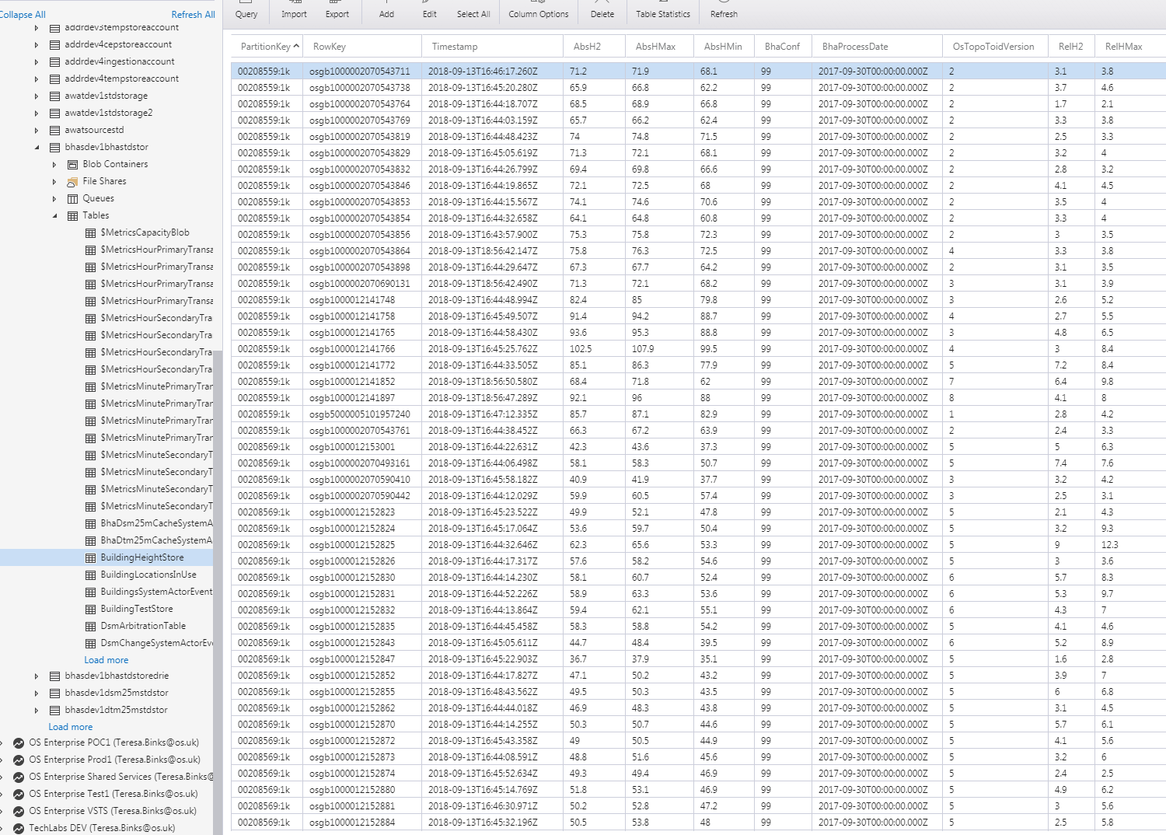

Slide 24
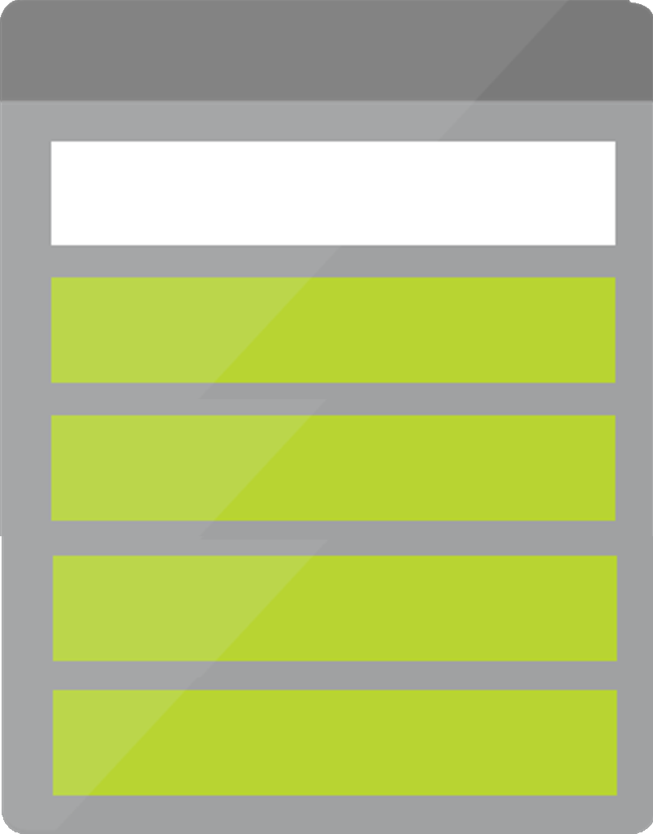
Developer
Laptop
Application
Version Control
Subscription
AAD – user and permission
Resource Group
WebApp + Application
Table Storage+ Storage Account
Need real data
Storage Account
Table
Storage Account >
Table Storage
Add Storage account to Resource Group – label the fact we’re using table storage

Slide 25
Developer
Laptop
Application
Version Control
Subscription
AAD – user and permission
Resource Group
WebApp + Application
Table Storage+ Storage Account
Connection String
Need to connect
Storage Account
// stg1ad4g7
Table

Slide 26
Developer
Laptop
Application
Version Control
Subscription
AAD – user and permission
Resource Group
WebApp + Application
Table Storage+ Storage Account
Connection String
Need to connect
Storage Account
// stg1ad4g7
Table

Slide 27

Developer
Laptop
Application
Version Control
Subscription
AAD – user and permission
Resource Group
WebApp + Application
Table Storage+ Storage Account
Need to connect
securely
Storage Account
// stg1ad4g7
// stg1ad4g7
Table
Key Vault
Add KeyVault – put Storage Account’s connection string in KeyVault

Slide 28
Table
Alex
// stg26ea39
Key Vault
Application
Contributor
Alex
eggs
Alex

Slide 29
They want more
As a
Local Authority
I want
a list of heighted Residential Buildings in an area
So That
I can use that data to make plans

Slide 30
Query the building heights data source
For every building
Simple Application
+ Execution Environment
This feels like a lot of work – we need more developers!

Slide 31

Roby
Name your new Developer – give them access to the subscription by adding them to both AAD and the ARM

Slide 32

Need to collaborate
on code
on work
Azure DevOps
Add Azure DevOps
Add Git and Work Items to Azure DevOps

Slide 33
Application
Push
Pull
Application
Application
Add Git to Developer 2’s laptop – Add application to Developer 2’s Git
Add application to Azure DevOps’ Git

Slide 34
Application
Pull
Push
Application
Application

Slide 35
Developer
Laptop
Application
Version Control
Subscription
AAD – user and permission
Resource Group
WebApp + Application
Table Storage+ Storage Account
2nd Developer+ git, application
Azure DevOps + git, application
Need to collaborate
effectively

Slide 36
Developer
Laptop
Application
Version Control
Subscription
AAD – user and permission
Resource Group
WebApp + Application
Table Storage+ Storage Account
2nd Developer+ git, application
Azure DevOps
Environments x2
Need to collaborate
effectively
alx1
in isolation
rby1
4 characters
Environments
Add an environment around your existing resource group
Add a second environment – build a new duplicate of your resource group
Give both environments a 4 character name, related to the developers

Slide 37

Alex
alx1
rby1
Roby
Table
Table
// stg26ea39
Key Vault
// stg3bb28c7
Key Vault
Application
Azure DevOps
Contributor
Application
Application
Alex
eggs
Contributor
Roby
eggs
Alex
Roby

Slide 38
Developer
Laptop
Application
Version Control
Subscription
AAD – user and permission
Resource Group
WebApp + Application
Table Storage+ Storage Account
2nd Developer+ git, application
Azure DevOps
Environments x2
Environments +2
Need to collaborate
effectively
alyx1
rby1
integrated
ci01
with stakeholders
prod
Environments
Add another environment – call it ci01
Add another environment – call it prod

Slide 39
Alex
alx1
rby1
Roby
Table
Table
// stg26ea39
Key Vault
// stg3bb28c7
Key Vault
Application
ci01
prod
Azure DevOps
Table
Table
Contributor
Application
Application
// stg1ad4g7
// stg49a5e3f
Alex
eggs
Key Vault
Key Vault
Contributor
Roby
eggs
Alex
Roby

Slide 40
What if we add even more developers or stakeholders?
Many real environments are much bigger
Configuration
Human error
Building things manually sucks
Automation

Slide 41
Need Infrastructure as Code
alx1
Application
WebApp Instances: 1
WebApp size: S1
Storage Account: 1
Key Vault: 1
Fill in an Infrastructure as Code template (as pictured above)
Add it to developer 1’s Git
Developer 1 pushes it to Azure DevOps – copy+paste the template and add it to Azure DevOps’ Git
Developer 2 pulls it from Azure DevOps – copy+paste the template and add it to Developer 2’s Git

Slide 42
Application
WebApp Instances: | 1
WebApp Size: | s1
Storage Account: | 1
Key Vault: | 1
Application
Application
WebApp Instances: | 1
WebApp Size: | s1
Storage Account: | 1
Key Vault: | 1
WebApp Instances: | 1
WebApp Size: | s1
Storage Account: | 1
Key Vault: | 1
Azure DevOps
Alex
Roby

Slide 43



Need Repeatability
Compile
Test
Package
ci01
Deploy to:
Deploy to:
Deploy to:
Application
ci01
WebApp : 1
Storage-Account: 1
Key Vault: 1
Deploy to:
Pipelines

Slide 44
Need Repeatability
Compile
Test
Package
prod
Deploy to:
Deploy to:
Deploy to:
Application
ci01
prod
WebApp : 1
Storage-Account: 1
Key Vault: 1
Deploy to:
Pipelines

Slide 45
alx1
Need Repeatability
Compile
Test
Package
Deploy to:
Deploy to:
Deploy to:
ci01
prod
alx1
Deploy to:
rby1
rby1
Add Build Pipeline and Release Pipeline to Azure DevOps. Fill in environments in the release, in whichever order you like.
Pipelines

Slide 46

Application
WebApp Instances: | 1
WebApp Size: | s1
Storage Account: | 1
Key Vault: | 1
Compile
Test
Package
ci01
prod
alx1
rby1
Azure DevOps

Slide 47
We did all this because we added a developer to our team.
Let’s revisit our product requirements:

Slide 48
As a
Local Authority
I want
a list of heighted Residential Buildings in an area
So That
I can use that data to make plans

Slide 49
Query the building heights data source
For every building
Simple Application
+ Execution Environment

Slide 50
First, we need a height source
Height is a separate product portfolio, with its own product team (Da Vinci)
Add the Height AzureDevOps Team Project.
Add an environment for BHA and name it “prod”.
Add a resource group for the resources
Add the BHA service

Slide 51
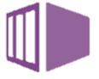

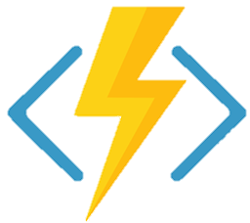
alx1
rby1
Application
Table
Table
Compile
Test
Package
// stg26ea39
ci01
prod
alx1
rby1
Key Vault
// stg3bb28c7
Azure DevOps
Key Vault
ci01
prod
Table
Table
// stg1ad4g7
// stg49a5e3f
prod
Key Vault
Key Vault
Height Team Project
Building Height Attribute Service
BHA Application
Infrastructure
BHA
?
?
?
?
Compile
Test
Package
prod
Azure DevOps

Slide 52
Need clear separation of responsibilities
4 characters
System
Add the BHA system (bhas).
Add your system, and name it.

Slide 53
rbts
alx1
rby1
Table
Table
// stg26ea39
Contributor
Key Vault
// stg3bb28c7
Key Vault
Alex
eggs
Contributor
Roby
eggs
ci01
prod
Table
Table
bhas
// stg1ad4g7
// stg49a5e3f
prod
Key Vault
Key Vault
Building Height Attribute Service
?
?
?
?

Slide 54
Query the building heights data source
For every building
Simple Application
+ Execution Environment

Slide 55
Developer
Laptop
Application
Version Control
Subscription
AAD – user and permission
Resource Group
WebApp + Application
Table Storage+ Storage Account
2nd Developer+ git, application
Azure DevOps
Environments x2
Environments + 4
Pipelines
Functions
Need to have massive, simple scalability
Application
Function
Add “Function” :”1” to you infrastructure as code.
That infrastructure gets deployed by your pipeline to each environment, so add a function to each of your environments.

Slide 56
rbts
alx1
rby1
Table
Table
// stg26ea39
Key Vault
// stg3bb28c7
Key Vault
ci01
prod
Table
Table
// stg1ad4g7
// stg49a5e3f
Key Vault
Key Vault

Slide 57

Developer
Laptop
Application
Version Control
Subscription
AAD – user and permission
Resource Group
WebApp + Application
Table Storage+ Storage Account
2nd Developer+ git, application
Azure DevOps
Environments x2
Environments + 4
Pipelines
Functions
Need to send messages
Storage Account
Queue

Slide 58
rbts
alx1
rby1
Table
Table
Queue
Queue
// stg26ea39
Key Vault
// stg3bb28c7
Key Vault
ci01
prod
Table
Table
Queue
Queue
// stg1ad4g7
// stg49a5e3f
Key Vault
Key Vault

Slide 59


So now we have a system that gives heights of residential buildings
Storage Account
Application
Table
Application
?
Building Heights System
Queue
Queue
WebApp

Slide 60
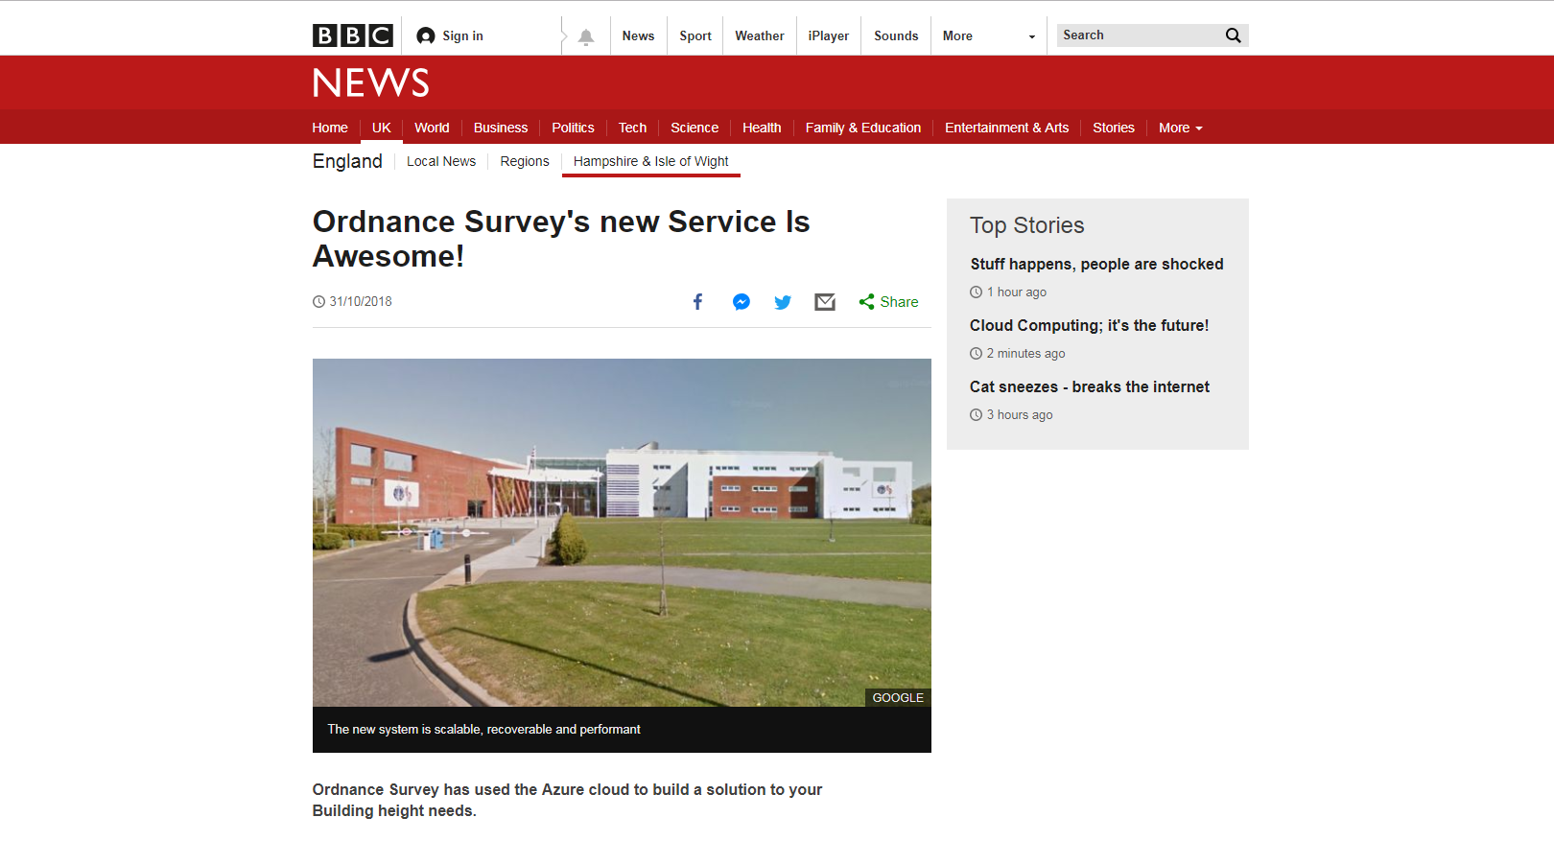

Slide 61

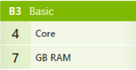
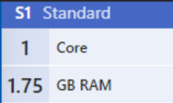
Our site is being hammered!
We need more capacity!
Panic!!!!!
“WebApp size: B3”
“WebApp size: S1”
WebApp
Infrastructure
Contrast to now…..
Self-Provisioning
Change the WebApp size on your infrastructure as code.
Attach a bigger WebApp instance to the back of the WebApps in each environment

Slide 62
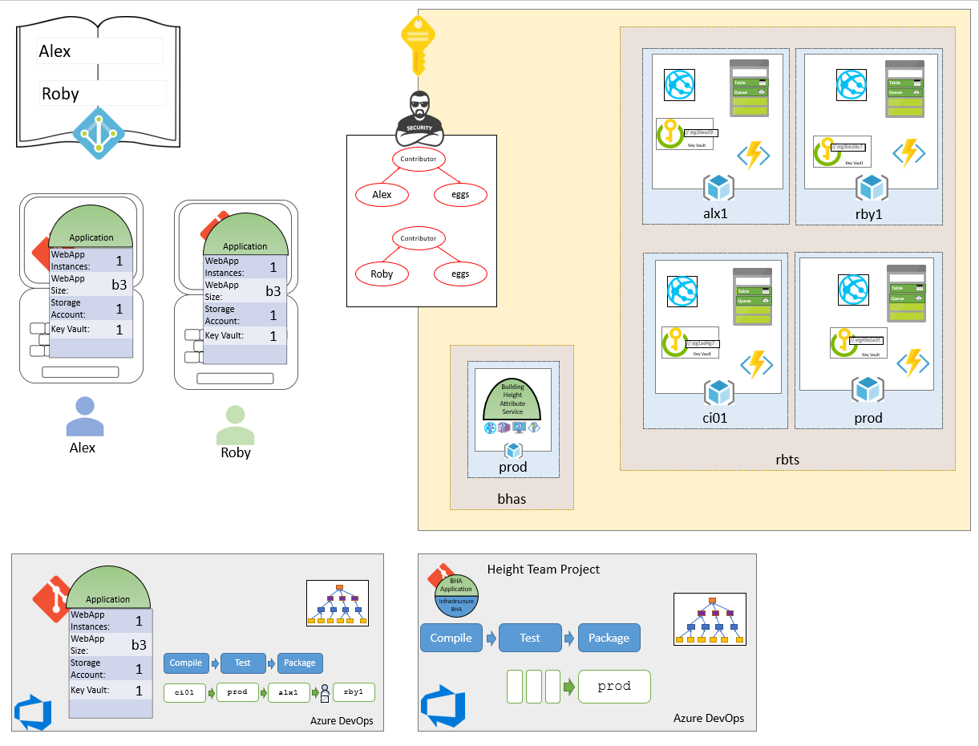

Slide 63
They want even more
As a
Local Authority
I want
a list of heighted Residential Buildings in an area
the population density of Residential Buildings in an area
So That
I can use that data to make plans

Slide 64
Office for National Statistics
Compressed file
Once a quarter
Somewhere to load
Something to unpack
(application and execution environment)
Somewhere to store

Slide 65

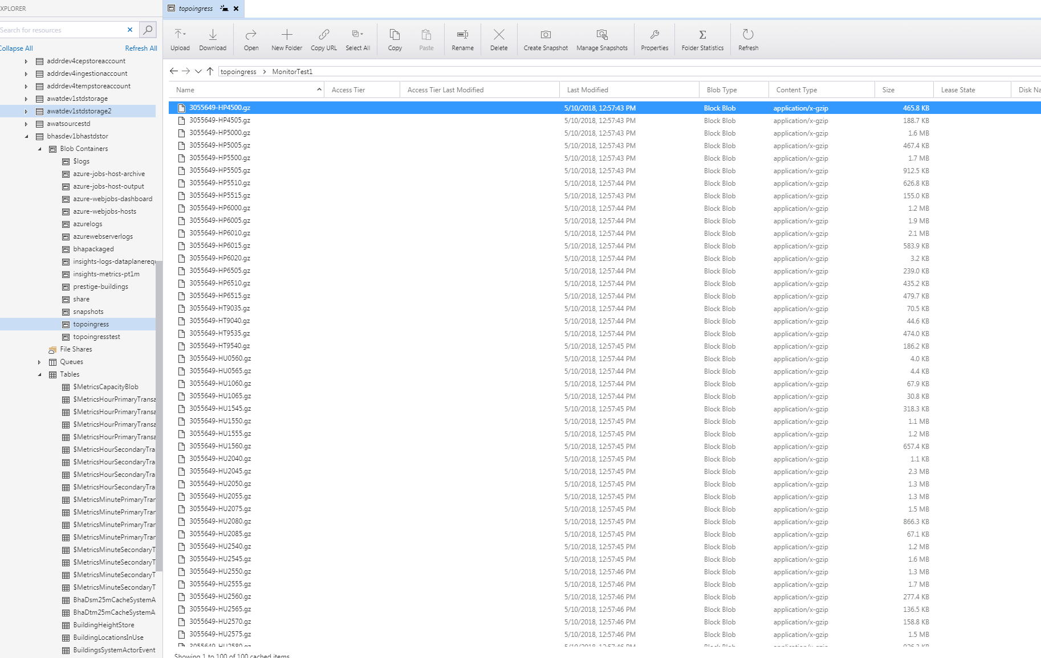
Need somewhere to load
Blob
Blob Storage

Slide 66
Need to unpack data
Application
Application
Execution Environment

Slide 67

Need to notice the file load
Event Grid

Slide 68
Need somewhere to store
Table
Blob
Storage account

Slide 69
Done!
But…..
It’s too slow…

Slide 70

Need more performance from storage
Table
Blob
Cosmos DB
Storage account

Slide 71

Breaking News!!!!! Again! OS’ new service is even more awesome!
Our site is being hammered!
We need more capacity!
Panic!!!!!
“WebApp size: B3”
“#Instances: 3”
“#Instances: 1”
Infrastructure
Contrast to now…..

Slide 72
Done!
What have we missed?

Slide 73
Storage things
Things that hold data

Slide 74

Storage Account
// stg1ad4g7
Table
Queue
Blob
File
File storage

Slide 75
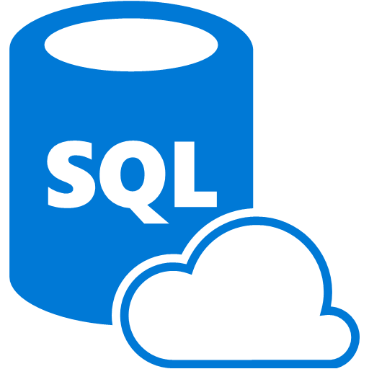


Azure SQL

Slide 76

Data Lake

Slide 77
Execution Environments
Application
Things that run code

Slide 78


Virtual Machines

Slide 79
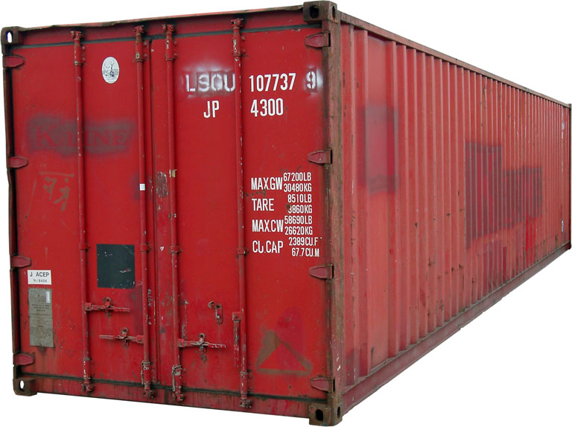
Containers

Slide 80
Messaging things
Things that pass messages

Slide 81

Service Bus
Queue Storage’s big brother

Slide 82

Event Hub

Slide 83
What’s my takeaway?
What is and isn’t Azure
What is my tech lead going on about with subscriptions and queues?
What’s the impact on me?

Slide 84

Your developers need you!
Time and space
Learn the new
Fear
Temptation to fall back to the traditional mindset
Particularly with project pressures
Application
Infrastructure
DevOps, infrastructure, support
are not job roles for individuals in your teams
they are team responsibilities, culture and practices.
Insist on it

Slide 85
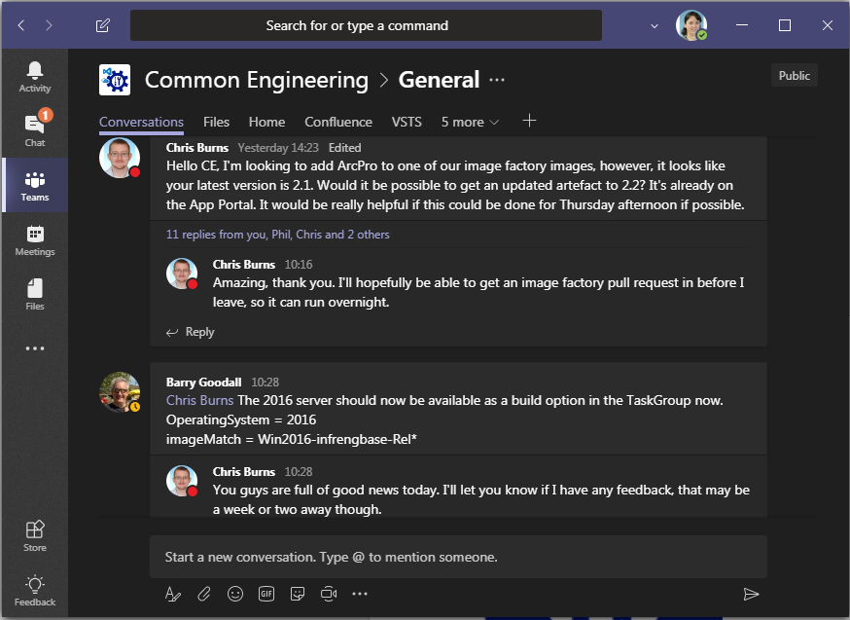

Common Engineering

Slide 87
The end : ) What questions do you have?
Feedback
It’s running again!

